Slide 1
Capstone Presentation
Soumya Ranjan Prusty
April 2020

Slide 2
Business Opportunity and Audience
Hypothetically, I am a commercial account executive at a local bank and I am considering opportunity in my area.
Little Elm, Texas is an up and coming suburb of North Dallas, and is currently developing at an intense rate. There is construction at every corner. This is a prime time to begin entrepreneurship. Little Elm is also landlocked by other cities, so this is the ideal opportunity to act in the business sector as either an investor or business operator, before the point of entry is saturated and opportunity becomes scarce.
Where should I invest money
5-10 options and compile my target list
Use for internal business and to share with clients

Slide 3
Data Description and Source
FourSquare Data (foresquare.com)
Types of businesses that already exist in Little Elm
Compare to Frisco, TX
Look for opportunity by business category

Slide 4
Methodology
Use data to determine the count of existing in available business categories provided by the ForeSquare data in Little Elm and Fricso
Calculate the volumes in each respective city and determine which categories have the most opportunity for growth in Little Elm
Compile this data by the highest and lowest counts for each city
Determine which categories to select for my final target list

Slide 5
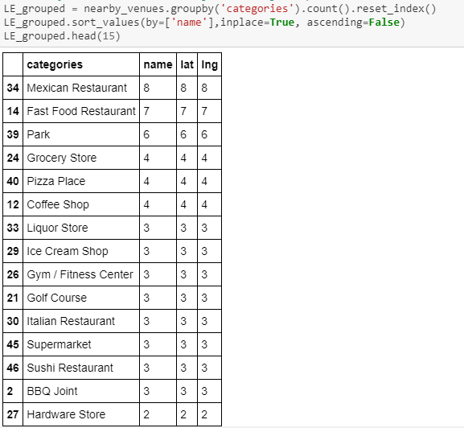
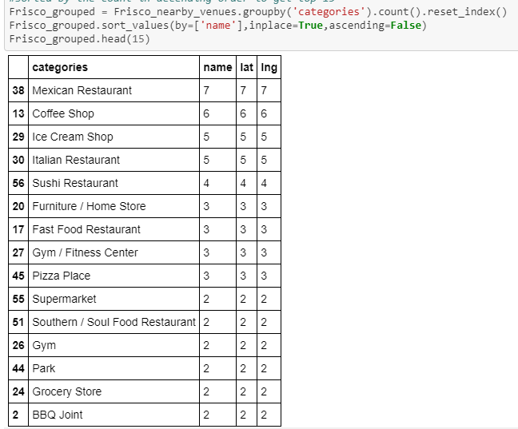
Project Findings and Recommendations
More businesses in common than expected meaning Little Elm is currently
doing a good job with the existing business landscape present
Compiled a Red, Yellow, Green list based on the data compiled (next slide)

Slide 6
Project Summary
If this were a real world exercise, I feel this data would really help me make business decisions!
Little Elm Targe Business Investement List
Green | Yellow | Red
Fried Chicken Shop | Coffee Shop | Fast Food
Sushi |  | Grocery
IceCream |  | Juice Bar
 |  | Lingerie Store
 |  | Museum

